Slide 1

Zowe 3Q 2021 PI Planning
ZLC / ZAC Update
Presenters: Bruce Armstrong, Michael DuBois, Peter Fandel

Slide 2
Topics
Summary of "state of the business" (Metrics and some anecdotal info)
A look back on 2Q accomplishments
Brief explanation of ZLC -> ZAC transition
What the ZAC to work on with TSC
Feedback from customers and corporate consumers

Slide 3
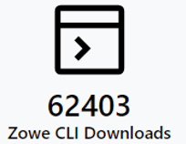
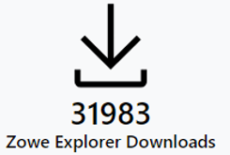
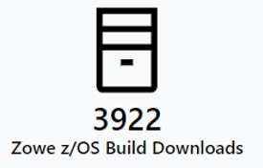
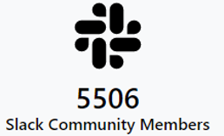
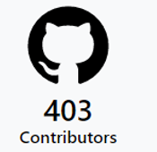
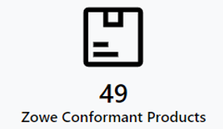
Zowe Open-Source Community Metrics
Another quarter of growth
(4/27/2021 – 7/22/2021)
73393
36342
4250
8361*
422
52
https://www.metrics.zowe.org

Slide 4
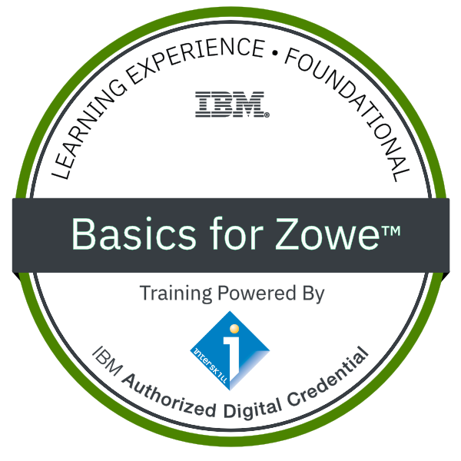
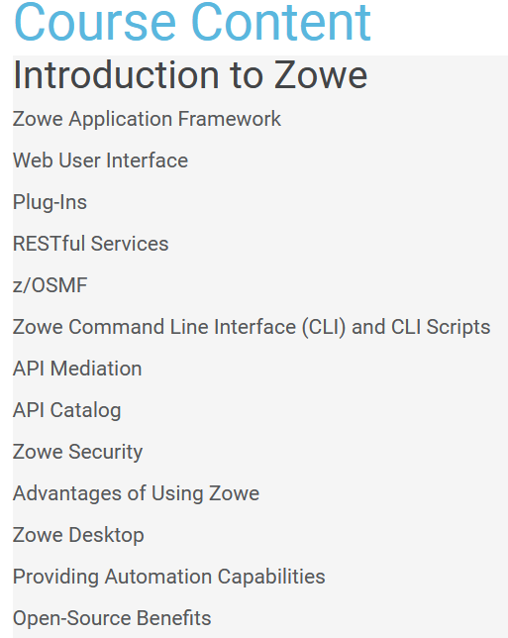
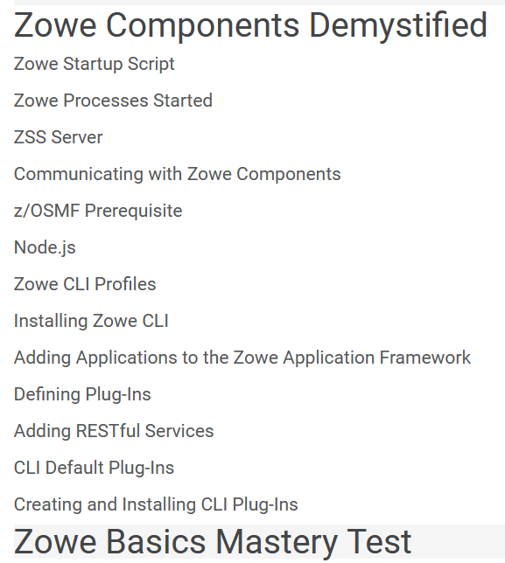

Education as Sign of Acceptance: Zowe Training Resources
Interskill – Basics for Zowe™
“Zowe 101” created in 2019 by Interskill Learning, authorized by IBM
3.5K+ badges issued by YE 2020, highest across all Z digital badge programs!
https://www.credly.com/org/interskill/badge/interskill-basics-for-zowe

Slide 5
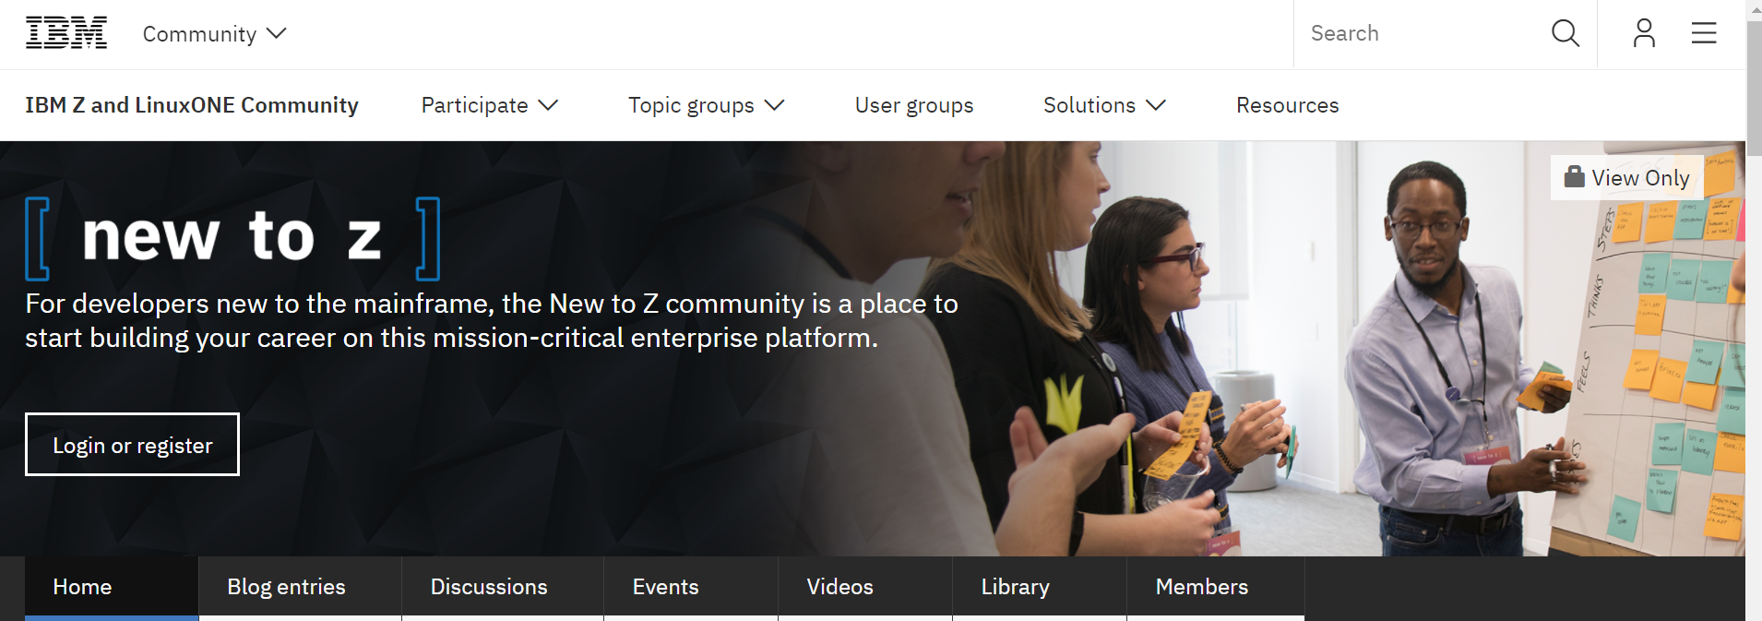
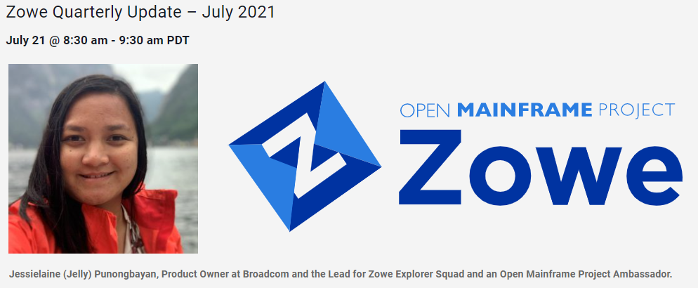
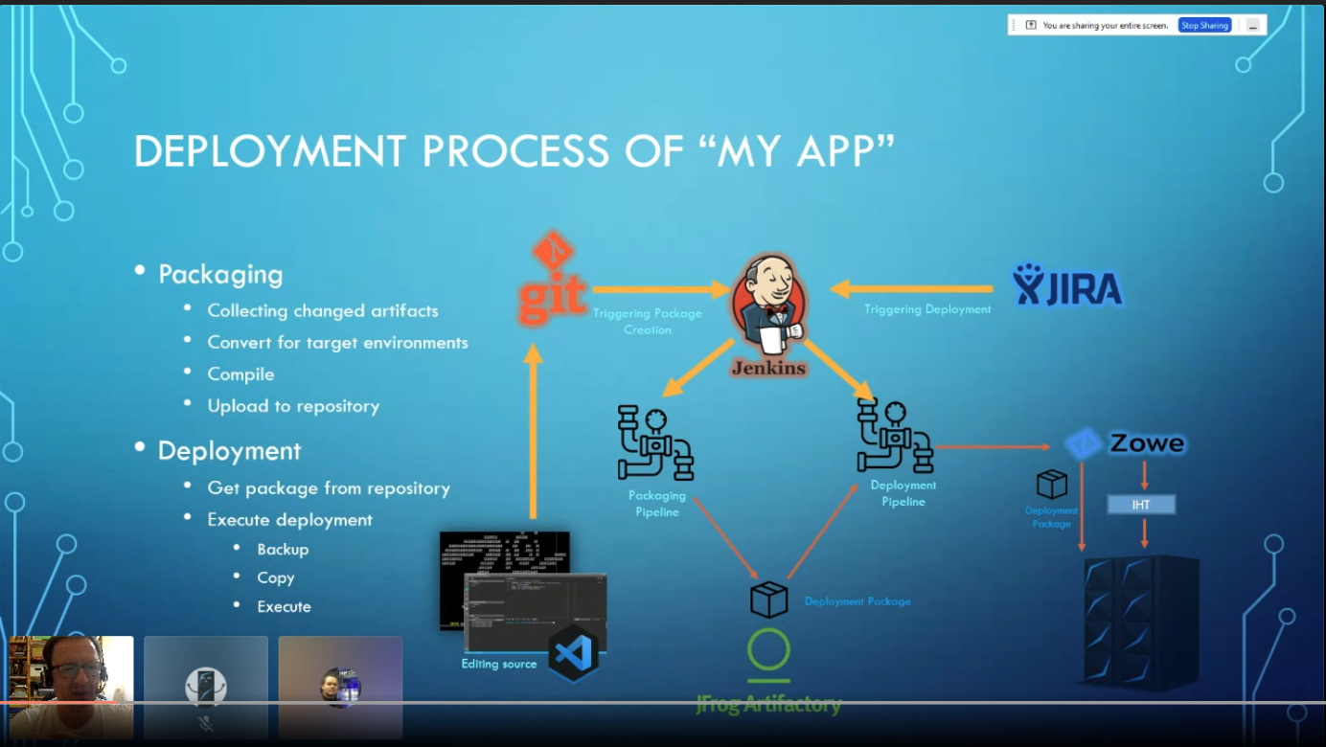
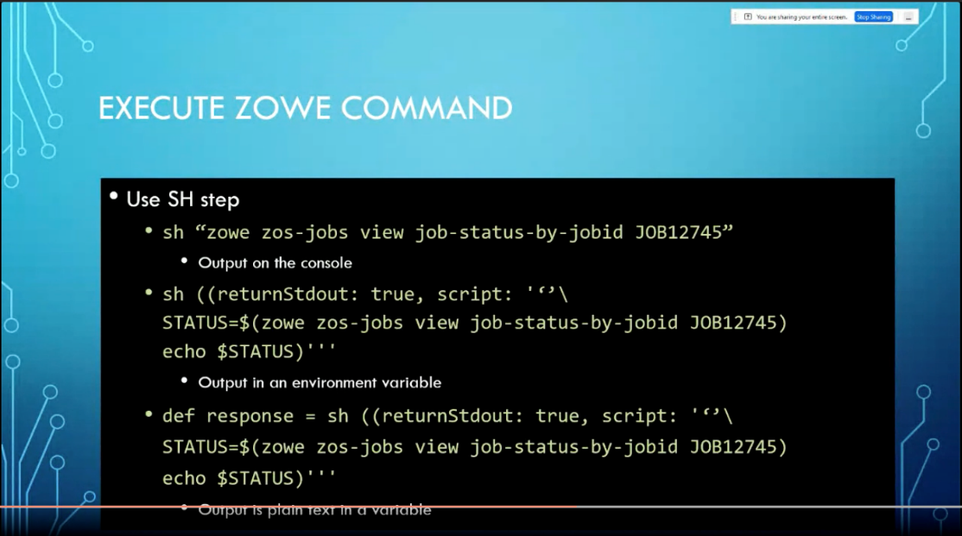
New to Z Community: 2 Zowe sessions already and a 3rd planned
The Community has taken an interest in Zowe
Link Here
Recent help with advertising the webinar:
Replays:
https://www.crowdcast.io/e/zowe-01
Zowe Overview
https://www.crowdcast.io/e/newtoz-july1421
Zowe use case with Jenkins
Real World Use with Jenkins

Slide 6


21PI2 Themes
High Availability
Security
Available for Technical Preview since 1.22!
Off-z Persistent Caching via Redis
Launcher to manage process restarts
Sample applications
Change Passwords via SAF
AT-TLS-Aware API ML
Secure Credential Store support for extenders of Zowe Explorer
Extending the
Community
New Incubators (IBA Group, BMC)
Zowe Extenders (Micro Focus, SEGUS)
New SDKs for Kotlin and Java
New VS Code Extension for CICS
Usability and Functional Improvements
Quarterly Update Webinar and Survey
7 New Zowe Blogs
Getting Started
Improved Documentation Site
Automated CLI Configuration
Streamlined Installation
Easier Certificate Configuration
Install & Configure without z/OSMF
Containerization
Conformance
New Conformance Proposals!
- Zowe Support Offerings
- Zowe Explorer
Notes:
Speaker – Mike DuBois
20PI3 CLI Squad Achievements
Zowe Client Python SDK published.
Has been published to Python Package Index
Check out the documentation: https://zowe-client-python-sdk.readthedocs.io/en/latest/packages/packages.html
Zowe Client Swift SDK is available in GitHub
-> https://github.com/zowe/zowe-client-swift-sdk.
Let us know your feedback! We will plan to publish some documentation around this in the next PI if there is interest.
Node SDK is nearly published.
Will be published to public npm
The corresponding SDK doc will be published and content will be added to Zowe.org once the Node SDK is live.
20PI3 API Squad Achievements
The API Squad closed over 140 Issues and PRs notably...
Removed the dependency of Zowe API ML on z/OSMF for authentication by adding SAF as an additional authentication provider (for obtaining the JWT) #472
The Swagger URL is now provided for z/OSMF. This URL provides full documentation containing the Try It Out functionality if the z/OSMF version supports the Swagger endpoint. Alternatively, the URL provides the info endpoint to directly enable access to Zowe endpoints. #665
The default configuration of API ML now supports character encoding. #777
Welcomed 2 new members - Jordan Cain & Carson Cook
20PI3 App Framework Squad Achievements
Revised and detailed HA/FT plan with other squads, significantly reducing the complexity of implementation and improving the expected user experience and HA/FT guarantees
Eliminated the need to implement a leader electrion algorithm in ZSS
Investigated potential state storage DBs for a good match; compiled redis on z/os to evaluate
Created an automated build pipeline for and posted to dockerhub a Dockerized release of Zowe's server runtimes as an option to run under Linux as an alternative to z/OS
Drafted documentation on how to use the docker image
Ran and concluded a mentorship program with the OMP for 4 mentees to enhance the app framework and kickstart new app development
20PI3 Zowe Explorer Squad
Enhanced user experience by introducing a configurable/toggleable profile validation mechanism. (v1.7.0, v1.9.0)
Improved installation speed and overall performance by bundling the extension using Webpack. (v1.8.0)
Augmented developer experience by implementing the `Allocate-Like` functionality to simplify the creation of datasets (v1.9.0)
Elevated user experience by grouping favorites into a more consistent profile-specific view (v1.9.0)
Tech Debt: Finalized unit and integration tests refactoring (Carry-over v1.7.0)
20PI3 Documentation Squad Achievements
Overall
API reference guide available (Thanks @Carson)
Release notes process streamlined with automation (This is a highlight, it helps every squad to deliver more efficiently)
Supported each Zowe 1.x.x release, curated contributions to documentation, and supported the community.
Zowe CLI
Created documentation for the Zowe Client SDKs. Download the SDKs from Zowe.org. (Note: doc isn't published yet, pending code delivery)
Documented how to leverage the SSO/MFA features in Zowe CLI, using the new "base profile" to store a token.
20PI3 Onboarding Squad Achievements
On-boarded a new ISV: Software Engineering (i.e. SEGUS Software) to Zowe
Introduced the V1 Conformance Program including
New Badges
Revised Terms & Conditions
Revised Test Criteria, Test Criteria Format and Test Criteria “storage” i.e. moved to GitHub
Introduced the Test Criteria Change Process
Transitioned the Metrics Gathering to new members, began researching automation, introduced “live pull” from Google sheets
Social Media Management of Medium.com/ZOWE
Categorized 54 blogs {CORE} or {Ecosystem}
Reviewed and introduced 9 new blogs in 19PI3
Established Zowe Quarterly Webinar series
Showcased: 11: API ML Conformant Extensions / 5: App Framework Conformant Extensions / 25: Conformant CLI Plug-ins

Slide 7
21PI2 Zowe Achievements
Zowe Systems Squad
High Availability in Technical Preview since 1.22!
Improved Zowe's certificate configuration experience
Support for installing and configuring Zowe without z/OSMF present
Onboarding new z/OS Infrastructure - z/OS 2.4 validation on Marist
HA: Introduced launcher to manage process restarts and moved app-server, ZSS state to caching service
App Server + apps in standalone Docker container (Technical Preview)
IP Explorer application released (including blog)
Delivered contribution guidelines explaining code organization and coding style
App-server/ZSS swagger in the API catalog
ZIS plugin installation improvements
Finalized the conformance criteria checklist together with the supporting technical implementation.
Delete multiple datasets and dataset members
Secure credential store support API for extenders
Significant improvements in Dataset, USS, Jobs tree, TSO commands and Profile Management
Team Configuration in Zowe Explorer (Tech Preview)
Zowe CLI Squad
Zowe API Squad
On-boarded the Kotlin SDK (contributed by IBA Group) and Java SDK (contributed by Broadcom) to Zowe
Automatic Zowe CLI Connection Configuration for Zowe-conformant API Services
Continued validation of `@next` features and made improvements based on feedback
Published @next CLI content to the Zowe Technical Preview section on Zowe Downloads
Validated Zowe CLI w/Node 16 (Becomes LTS in October)
Migrated Zowe doc site to a new framework to provide an enhanced content experience
Published a blog to introduce all the new features on the Zowe doc site
Completed documentation for 2 new releases
Set up preview links for doc PRs and staging site w/Netlify.
Started content improvement for installing and extending
Published technical preview for High Availability - completed caching API off-z persistent solution via Redis and validated high availability for the API ML
Passwords change via SAF
Deterministic routing for user requests partially delivered - full server side targeted for 1.24
Completed development of an AT-TLS aware Zowe API ML for release in upcoming Zowe 1.24
Assisted in preparing conformance requirements and logistics for two new conformance programs
Completed logistical work associated with 2 incubator projects (Workflow wiZard, JetBrains)
On-boarded new extenders: Micro Focus, SEGUS
Influenced publication of a CICS VS Code extension
In collaboration with OMP, created and managed a dedicated conference tracking list
Prepared & delivered quarterly webinar update
Preliminary work prepared for semi-annual survey
OMP Zowe Release Overview BLOG series
Medium.com: Reviewed / introduced 7 new blogs
Zowe App Framework Squad
Zowe Onboarding Squad
Zowe Documentation Squad
Zowe Explorer
Notes:
Speaker – Mike DuBois
20PI3 CLI Squad Achievements
Zowe Client Python SDK published.
Has been published to Python Package Index
Check out the documentation: https://zowe-client-python-sdk.readthedocs.io/en/latest/packages/packages.html
Zowe Client Swift SDK is available in GitHub
-> https://github.com/zowe/zowe-client-swift-sdk.
Let us know your feedback! We will plan to publish some documentation around this in the next PI if there is interest.
Node SDK is nearly published.
Will be published to public npm
The corresponding SDK doc will be published and content will be added to Zowe.org once the Node SDK is live.
20PI3 API Squad Achievements
The API Squad closed over 140 Issues and PRs notably...
Removed the dependency of Zowe API ML on z/OSMF for authentication by adding SAF as an additional authentication provider (for obtaining the JWT) #472
The Swagger URL is now provided for z/OSMF. This URL provides full documentation containing the Try It Out functionality if the z/OSMF version supports the Swagger endpoint. Alternatively, the URL provides the info endpoint to directly enable access to Zowe endpoints. #665
The default configuration of API ML now supports character encoding. #777
Welcomed 2 new members - Jordan Cain & Carson Cook
20PI3 App Framework Squad Achievements
Revised and detailed HA/FT plan with other squads, significantly reducing the complexity of implementation and improving the expected user experience and HA/FT guarantees
Eliminated the need to implement a leader electrion algorithm in ZSS
Investigated potential state storage DBs for a good match; compiled redis on z/os to evaluate
Created an automated build pipeline for and posted to dockerhub a Dockerized release of Zowe's server runtimes as an option to run under Linux as an alternative to z/OS
Drafted documentation on how to use the docker image
Ran and concluded a mentorship program with the OMP for 4 mentees to enhance the app framework and kickstart new app development
20PI3 Zowe Explorer Squad
Enhanced user experience by introducing a configurable/toggleable profile validation mechanism. (v1.7.0, v1.9.0)
Improved installation speed and overall performance by bundling the extension using Webpack. (v1.8.0)
Augmented developer experience by implementing the `Allocate-Like` functionality to simplify the creation of datasets (v1.9.0)
Elevated user experience by grouping favorites into a more consistent profile-specific view (v1.9.0)
Tech Debt: Finalized unit and integration tests refactoring (Carry-over v1.7.0)
20PI3 Documentation Squad Achievements
Overall
API reference guide available (Thanks @Carson)
Release notes process streamlined with automation (This is a highlight, it helps every squad to deliver more efficiently)
Supported each Zowe 1.x.x release, curated contributions to documentation, and supported the community.
Zowe CLI
Created documentation for the Zowe Client SDKs. Download the SDKs from Zowe.org. (Note: doc isn't published yet, pending code delivery)
Documented how to leverage the SSO/MFA features in Zowe CLI, using the new "base profile" to store a token.
20PI3 Onboarding Squad Achievements
On-boarded a new ISV: Software Engineering (i.e. SEGUS Software) to Zowe
Introduced the V1 Conformance Program including
New Badges
Revised Terms & Conditions
Revised Test Criteria, Test Criteria Format and Test Criteria “storage” i.e. moved to GitHub
Introduced the Test Criteria Change Process
Transitioned the Metrics Gathering to new members, began researching automation, introduced “live pull” from Google sheets
Social Media Management of Medium.com/ZOWE
Categorized 54 blogs {CORE} or {Ecosystem}
Reviewed and introduced 9 new blogs in 19PI3
Established Zowe Quarterly Webinar series
Showcased: 11: API ML Conformant Extensions / 5: App Framework Conformant Extensions / 25: Conformant CLI Plug-ins

Slide 8
Proposal Summary: Zowe Support Conformance Program
The Zowe Conformance Program gives Zowe users the confidence that their experience will match their expectations for functionality, interoperability, usability, and support.
A vendor may apply for conformance by declaring the scope of their support offering and agreeing to the key principles of the program.
Conformance may be earned for one, some or all components of Zowe
Conformance badges will be administered by the Open Mainframe Project
Vendors must declare to the OMP the names of their support representatives for each component they support.
Key principles include:
Agree to support any authentic build of Zowe regardless of where it was downloaded (including zowe.org or from another vendor)
Agree to report problems potentially impacting other Zowe users and to work with the Zowe Security team
Follow all policies and practices for contributing to Zowe established by the Zowe Technical Steering Committee (TSC)
For more information: https://www.openmainframeproject.org/projects/zowe/conformance
https://github.com/zowe/zlc/issues/182
Notes:
https://www.openmainframeproject.org/projects/zowe/conformance
The Zowe Conformance Program aims to give users the confidence that when they use a product, app, or distribution that leverages Zowe they can expect a high level of common functionality, interoperability and user experience.
Conformance provides Independent Software Vendors (ISVs), System Integrators (SIs) and end users greater confidence that their software will behave as expected. Just like Zowe, the Conformance program will continue to evolve and is being developed by committers and contributors in the community. The Zowe Conformance Program is administered by the Open Mainframe Project.
All vendors are invited to submit conformance testing results for review and approval by the Open Mainframe Project. If your company provides software based on Zowe, we encourage you to get certified today.

Slide 9
You can call me “Zack”
The Zowe Leadership Committee (ZLC) is Changing to the Zowe Advisory Council (ZAC)
The TSC is head of Zowe engineering.
The ZAC is head of Zowe product management.
The TSC is in charge
…but we hope the TSC will still pay attention to us
Notes:
Speaker – Mike DuBois
20PI3 CLI Squad Achievements
Zowe Client Python SDK published.
Has been published to Python Package Index
Check out the documentation: https://zowe-client-python-sdk.readthedocs.io/en/latest/packages/packages.html
Zowe Client Swift SDK is available in GitHub
-> https://github.com/zowe/zowe-client-swift-sdk.
Let us know your feedback! We will plan to publish some documentation around this in the next PI if there is interest.
Node SDK is nearly published.
Will be published to public npm
The corresponding SDK doc will be published and content will be added to Zowe.org once the Node SDK is live.
20PI3 API Squad Achievements
The API Squad closed over 140 Issues and PRs notably...
Removed the dependency of Zowe API ML on z/OSMF for authentication by adding SAF as an additional authentication provider (for obtaining the JWT) #472
The Swagger URL is now provided for z/OSMF. This URL provides full documentation containing the Try It Out functionality if the z/OSMF version supports the Swagger endpoint. Alternatively, the URL provides the info endpoint to directly enable access to Zowe endpoints. #665
The default configuration of API ML now supports character encoding. #777
Welcomed 2 new members - Jordan Cain & Carson Cook
20PI3 App Framework Squad Achievements
Revised and detailed HA/FT plan with other squads, significantly reducing the complexity of implementation and improving the expected user experience and HA/FT guarantees
Eliminated the need to implement a leader electrion algorithm in ZSS
Investigated potential state storage DBs for a good match; compiled redis on z/os to evaluate
Created an automated build pipeline for and posted to dockerhub a Dockerized release of Zowe's server runtimes as an option to run under Linux as an alternative to z/OS
Drafted documentation on how to use the docker image
Ran and concluded a mentorship program with the OMP for 4 mentees to enhance the app framework and kickstart new app development
20PI3 Zowe Explorer Squad
Enhanced user experience by introducing a configurable/toggleable profile validation mechanism. (v1.7.0, v1.9.0)
Improved installation speed and overall performance by bundling the extension using Webpack. (v1.8.0)
Augmented developer experience by implementing the `Allocate-Like` functionality to simplify the creation of datasets (v1.9.0)
Elevated user experience by grouping favorites into a more consistent profile-specific view (v1.9.0)
Tech Debt: Finalized unit and integration tests refactoring (Carry-over v1.7.0)
20PI3 Documentation Squad Achievements
Overall
API reference guide available (Thanks @Carson)
Release notes process streamlined with automation (This is a highlight, it helps every squad to deliver more efficiently)
Supported each Zowe 1.x.x release, curated contributions to documentation, and supported the community.
Zowe CLI
Created documentation for the Zowe Client SDKs. Download the SDKs from Zowe.org. (Note: doc isn't published yet, pending code delivery)
Documented how to leverage the SSO/MFA features in Zowe CLI, using the new "base profile" to store a token.
20PI3 Onboarding Squad Achievements
On-boarded a new ISV: Software Engineering (i.e. SEGUS Software) to Zowe
Introduced the V1 Conformance Program including
New Badges
Revised Terms & Conditions
Revised Test Criteria, Test Criteria Format and Test Criteria “storage” i.e. moved to GitHub
Introduced the Test Criteria Change Process
Transitioned the Metrics Gathering to new members, began researching automation, introduced “live pull” from Google sheets
Social Media Management of Medium.com/ZOWE
Categorized 54 blogs {CORE} or {Ecosystem}
Reviewed and introduced 9 new blogs in 19PI3
Established Zowe Quarterly Webinar series
Showcased: 11: API ML Conformant Extensions / 5: App Framework Conformant Extensions / 25: Conformant CLI Plug-ins

Slide 10
The role of the ZAC
With the establishment of the Zowe Technical Steering Committee (TSC), the role of the ZLC is changing
The ZAC will be a council of stakeholders (Product Managers, Vendors, Universities, Other open-source projects, …)
The purpose is to debate and consolidate the needs and wishes of the stakeholders. The ZAC will own issues the TSC requests
Example issues:
Guiding principles to be considered
Projects/incubators maturity
Future hills based on indicators of market needs
New version considerations
New conformance criteria considerations
Releases MVP
Maintaining vendor neutral policy
New member recruitment
ZAC:
Everyone is welcome to participate
Operates on a consensus basis
Standing meetings Tuesdays 9am eastern
See https://lists.openmainframeproject.org/calendar (Creation of Linux Foundation account is needed)
More info https://github.com/zowe/zlc/issues/220
Come make the ZAC what you want it to be
Notes:
Speaker – Mike DuBois
20PI3 CLI Squad Achievements
Zowe Client Python SDK published.
Has been published to Python Package Index
Check out the documentation: https://zowe-client-python-sdk.readthedocs.io/en/latest/packages/packages.html
Zowe Client Swift SDK is available in GitHub
-> https://github.com/zowe/zowe-client-swift-sdk.
Let us know your feedback! We will plan to publish some documentation around this in the next PI if there is interest.
Node SDK is nearly published.
Will be published to public npm
The corresponding SDK doc will be published and content will be added to Zowe.org once the Node SDK is live.
20PI3 API Squad Achievements
The API Squad closed over 140 Issues and PRs notably...
Removed the dependency of Zowe API ML on z/OSMF for authentication by adding SAF as an additional authentication provider (for obtaining the JWT) #472
The Swagger URL is now provided for z/OSMF. This URL provides full documentation containing the Try It Out functionality if the z/OSMF version supports the Swagger endpoint. Alternatively, the URL provides the info endpoint to directly enable access to Zowe endpoints. #665
The default configuration of API ML now supports character encoding. #777
Welcomed 2 new members - Jordan Cain & Carson Cook
20PI3 App Framework Squad Achievements
Revised and detailed HA/FT plan with other squads, significantly reducing the complexity of implementation and improving the expected user experience and HA/FT guarantees
Eliminated the need to implement a leader electrion algorithm in ZSS
Investigated potential state storage DBs for a good match; compiled redis on z/os to evaluate
Created an automated build pipeline for and posted to dockerhub a Dockerized release of Zowe's server runtimes as an option to run under Linux as an alternative to z/OS
Drafted documentation on how to use the docker image
Ran and concluded a mentorship program with the OMP for 4 mentees to enhance the app framework and kickstart new app development
20PI3 Zowe Explorer Squad
Enhanced user experience by introducing a configurable/toggleable profile validation mechanism. (v1.7.0, v1.9.0)
Improved installation speed and overall performance by bundling the extension using Webpack. (v1.8.0)
Augmented developer experience by implementing the `Allocate-Like` functionality to simplify the creation of datasets (v1.9.0)
Elevated user experience by grouping favorites into a more consistent profile-specific view (v1.9.0)
Tech Debt: Finalized unit and integration tests refactoring (Carry-over v1.7.0)
20PI3 Documentation Squad Achievements
Overall
API reference guide available (Thanks @Carson)
Release notes process streamlined with automation (This is a highlight, it helps every squad to deliver more efficiently)
Supported each Zowe 1.x.x release, curated contributions to documentation, and supported the community.
Zowe CLI
Created documentation for the Zowe Client SDKs. Download the SDKs from Zowe.org. (Note: doc isn't published yet, pending code delivery)
Documented how to leverage the SSO/MFA features in Zowe CLI, using the new "base profile" to store a token.
20PI3 Onboarding Squad Achievements
On-boarded a new ISV: Software Engineering (i.e. SEGUS Software) to Zowe
Introduced the V1 Conformance Program including
New Badges
Revised Terms & Conditions
Revised Test Criteria, Test Criteria Format and Test Criteria “storage” i.e. moved to GitHub
Introduced the Test Criteria Change Process
Transitioned the Metrics Gathering to new members, began researching automation, introduced “live pull” from Google sheets
Social Media Management of Medium.com/ZOWE
Categorized 54 blogs {CORE} or {Ecosystem}
Reviewed and introduced 9 new blogs in 19PI3
Established Zowe Quarterly Webinar series
Showcased: 11: API ML Conformant Extensions / 5: App Framework Conformant Extensions / 25: Conformant CLI Plug-ins

Slide 11
What the ZAC is doing this PI
Completion of the ZAC Charter
Introduce Conformance Program for Zowe Support Offerings
Refining incubation process (acceptance and promotion criteria)
Providing input to Zowe community principles
Zowe V2 messaging – what does it mean for consumers
Listening and forwarding feedback from corporate consumers…

Slide 12
Listening to Zowe consumers – the top six
Up and running experience
Containerization (see #1) with orchestration
Customers and Extenders are asking for continued improvements to up-and-running experience.
Customers of Zowe extender products are demanding containerization now (in part for easier up and running).
Latest design is architecturally sound. MVP means MVP. Let’s go!
High Availability /Fault Tolerant delivery
Expanded Packaging Options (PSI support)
New version messaging/timing
How best to ensure robust security in our deliveries

Slide 13
Already thinking about 2022 PIs
Medallia / NPS infrastructure
EDU conformance badge program
ChatOps
Integration with other open-source projects
Extender/Consumers
Register
3rd Party NPS Capture
?
What do we mean:
Zowe Components
Consistent NPS Collection Process/Prompts

Slide 14
Q&A

